Slide 1
Maintaining Professor Scholarship on the TJSL Website
Patricia Ramert Web Application Developer
June 22, 2012

Slide 2
Talking Points
About TJSL Professor Profiles
Version Iterations and Exploration
The “Scholar” Module
Demo

Slide 3
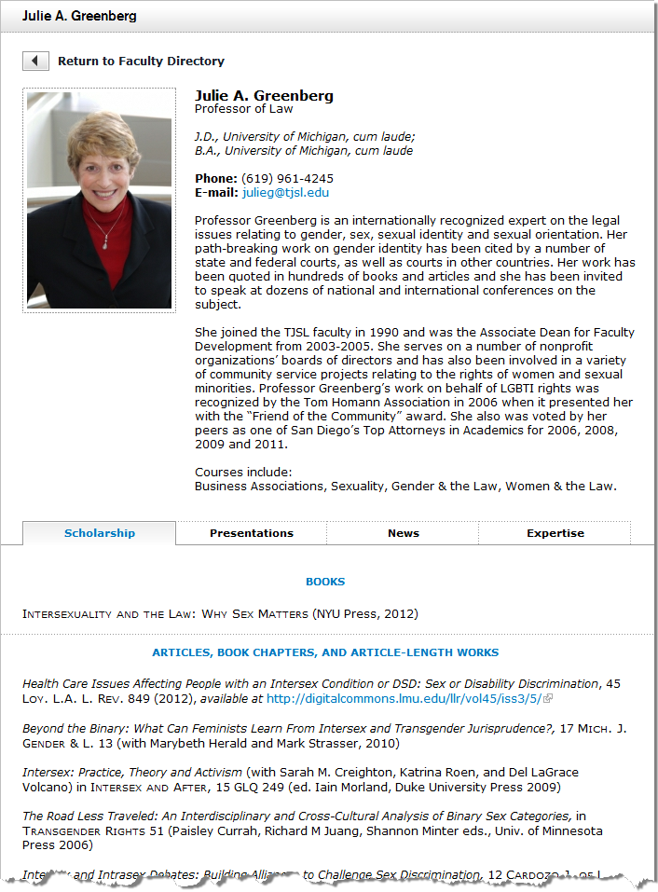
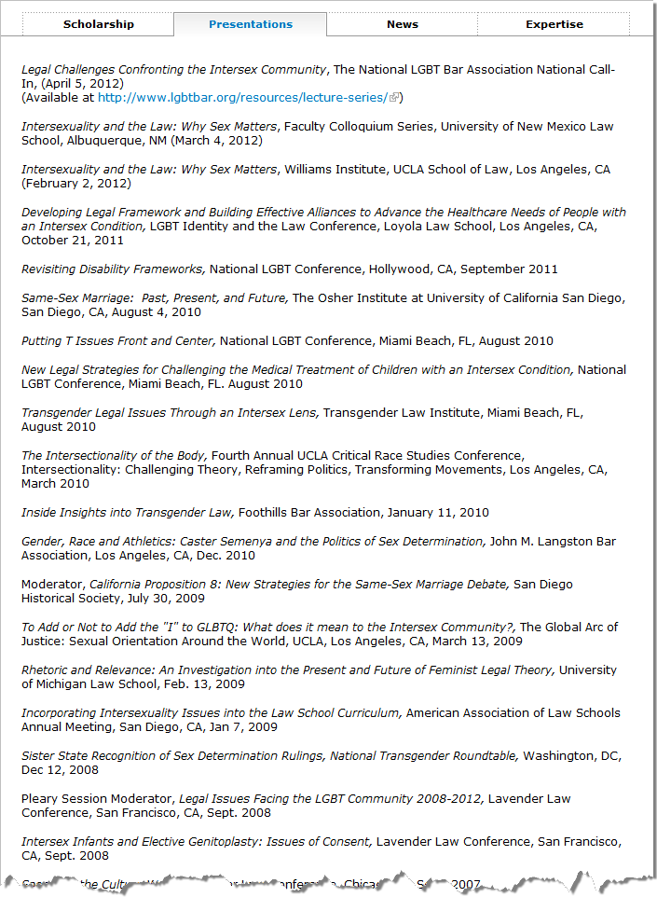
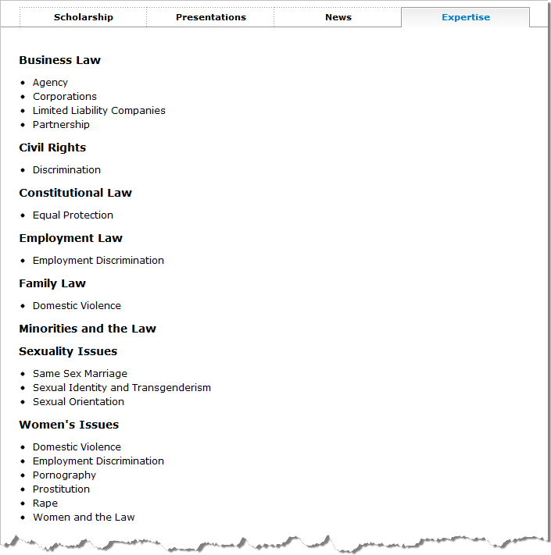
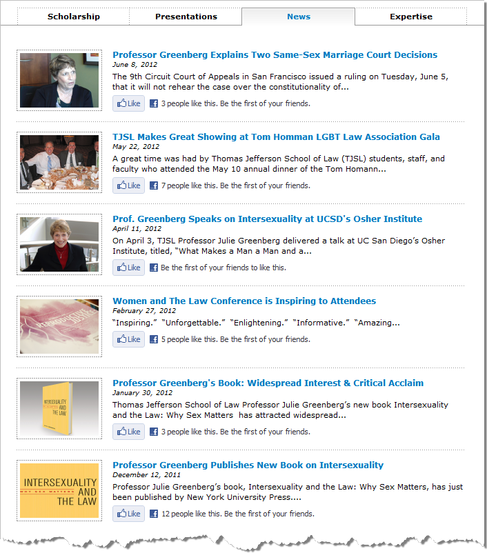
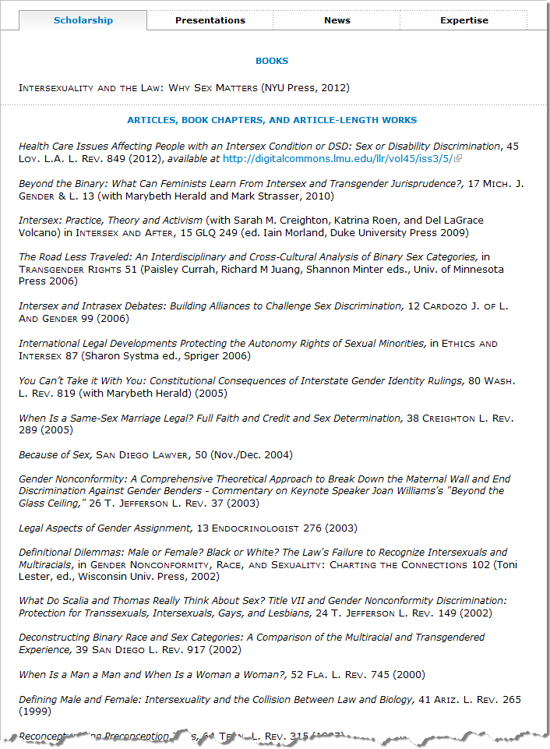
About TJSL Professor Profiles
Biography
Scholarship
Books
Editorships
Scholarly Articles
Presentations
News
Expertise
http://www.tjsl.edu/tjsl-faculty
http://www.tjsl.edu/directory/julie-greenberg

Slide 4
About TJSL Professor Profiles (con’t)
 | October 2010 | June 2012
Books | 79 (17 professors) | 76 (19 professors)
Editorships | 29 (9 professors) | 29 (13 professors)
Scholarly Articles | 664 (45 professors) | 714 (46 professors)
Presentations | 589 (36 professors) | 665 (35 professors)
Total | 1361 (107 professors) | 1484 (113 professors)
Book Citation 1
Book Citation 1
Book Citation 2
Book Citation 3
Book Citation 2
Book Citation 3

Slide 6
Version #1
Profile Content Type
First Name
Last Name
Job Title
Phone
E-mail
Office Number
Employee Type
Biography
Education
Expertise
Photo
Unique ID (nid)
Books
Book 1
Book 2 . . .
Book n
Editorships
Editorship 1
Editorship 2 . . .
Editorship n
Articles
Article 1
Article 2 . . .
Article n
Presentations
Presentation 1
Presentation 2 . . .
Presentation n
One place to edit them all!
http://ragemaker.net/images/?img=Happy/09.png

Slide 8
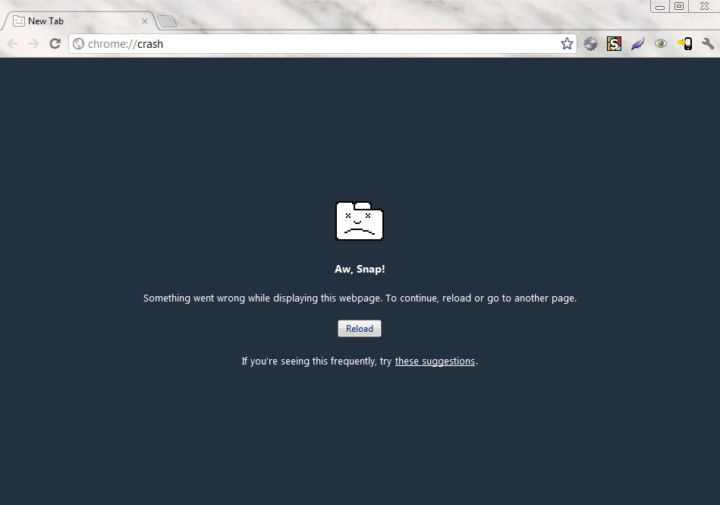

Slide 9
Version #2
Profile Content Type
Books Content Type
Editorships Content Type
First Name
Last Name
Job Title
Phone
E-mail
Office Number
Employee Type
Biography
Education
Expertise
Photo
Unique ID (nid)
Unique ID (nid)
Books
Book 1
Book 2 . . .
Book n
Unique ID (nid)
Editorships
Editorship 1
Editorship 2 . . .
Editorship n
Articles Content Type
Presentations Content Type
Unique ID (nid)
Articles
Article 1
Article 2 . . .
Article n
Unique ID (nid)
Presentations
Presentation 1
Presentation 2 . . .
Presentation n
Oh man, this is going to work!
http://ragemaker.net/images/?img=Happy/11.png

Slide 10
Why do you keep crashing?
http://ragemaker.net/images/?img=Sad/10.png

Slide 11
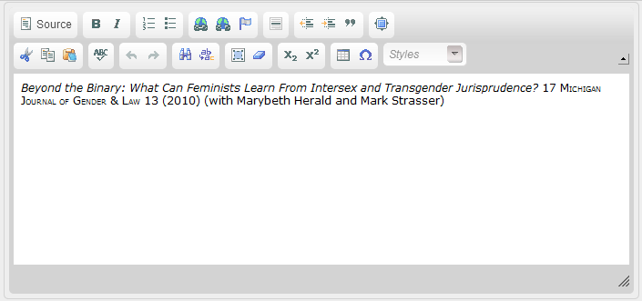
What Happened?
CKEditor
Plain Text Editor

Slide 13
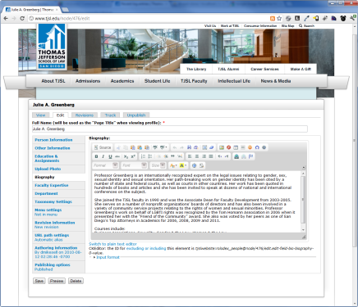
Previous Workflow
Submit paper form
Format citation
Updates via email
Update site via copy & paste
Review citations
Updates
via email

Slide 15
Team Players
Diana Mikesell Web & Graphics Coordinator
Lori Wulfemeyer Communications Director
Donna Gehlken Faculty Assistant
Patty Ramert Web Application Developer
James Cooper Former TJSL CIO
Catherine Deane
Reference Librarian
Julie Greenberg
Professor of Law

Slide 16
The Need
Paperless
Reduce copying, pasting, and reformatting
Reduce time to update professor pages
Workflow and revision tracking
Forms
Citation Metadata
Stop browser crashes

Slide 18
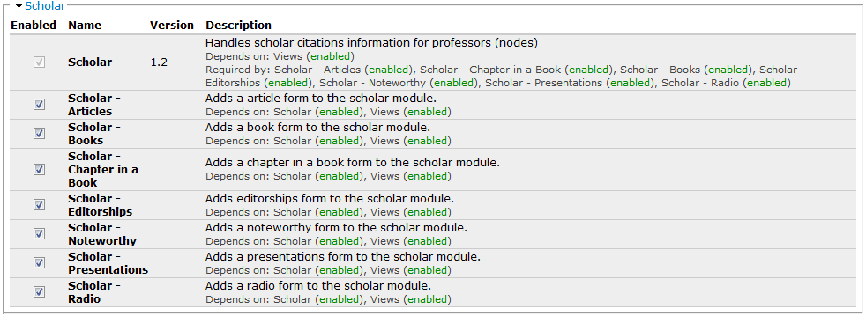
Enable Scholar

Slide 19
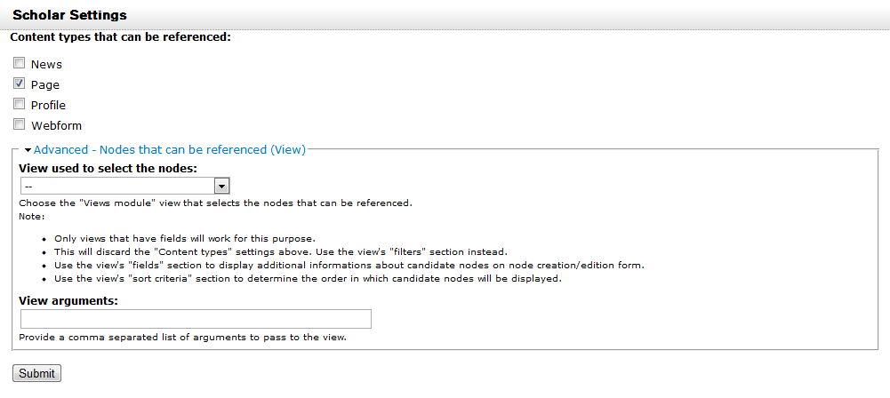
Scholar Configuration

Slide 20
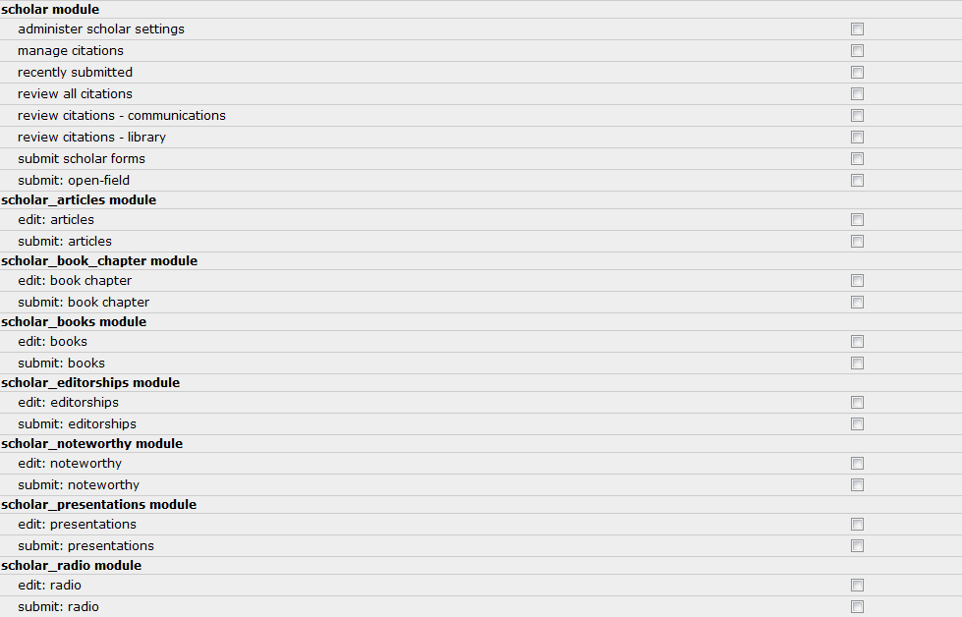
Scholar Permissions

Slide 21
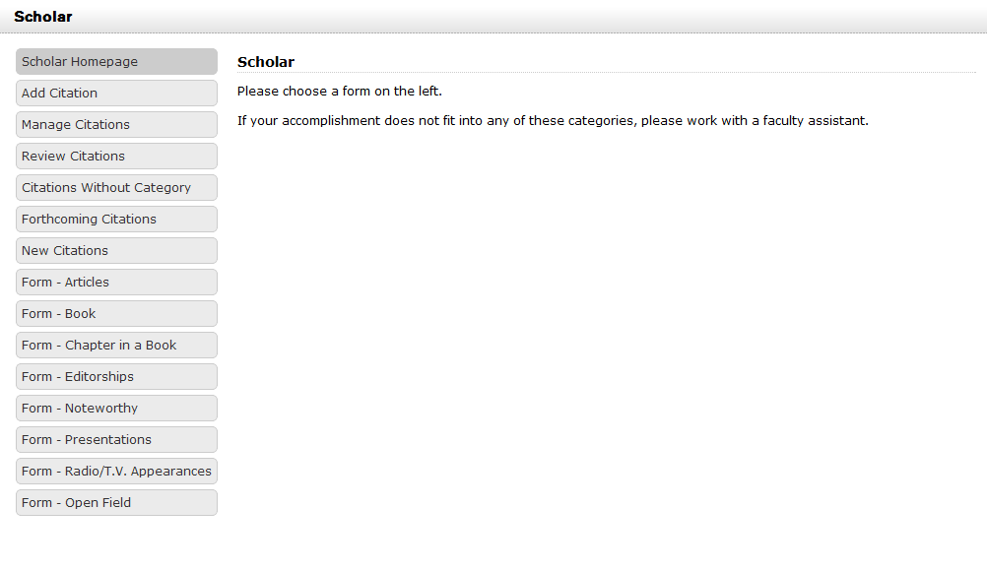
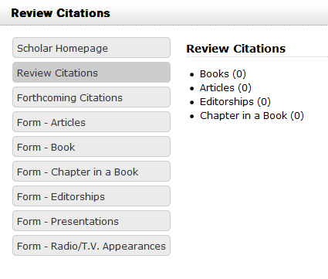
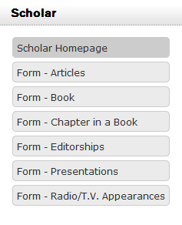
Scholar Homepage

Slide 22
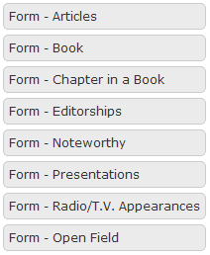
Scholar Forms
Articles
Books
Book Chapter
Editorships
Presentations
Radio & TV Appearances
Noteworthy
Open Field

Slide 23
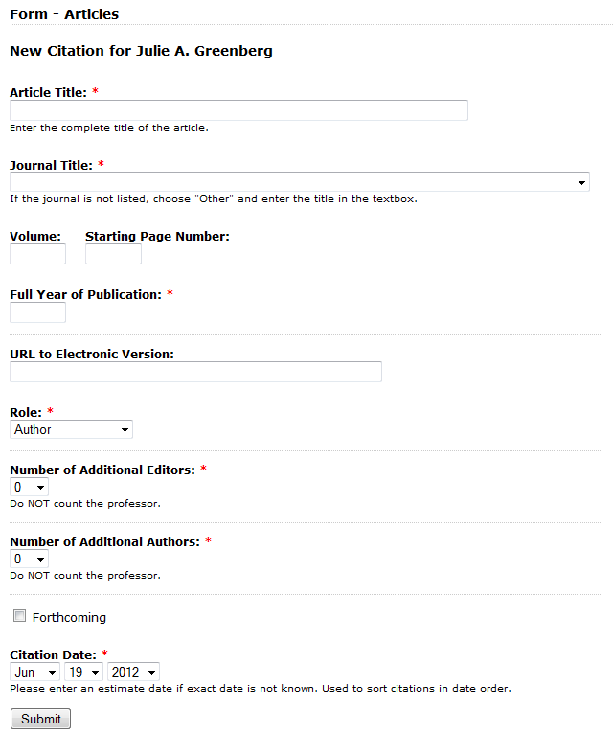
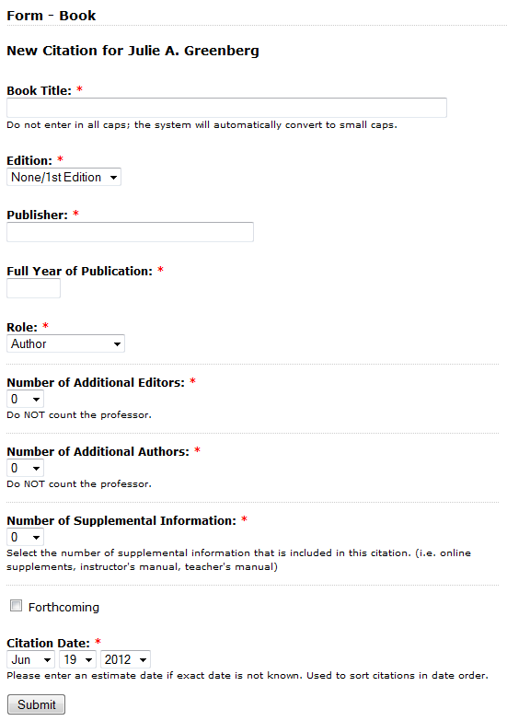
Forms
Articles
Book

Slide 24
CLICK

Slide 25
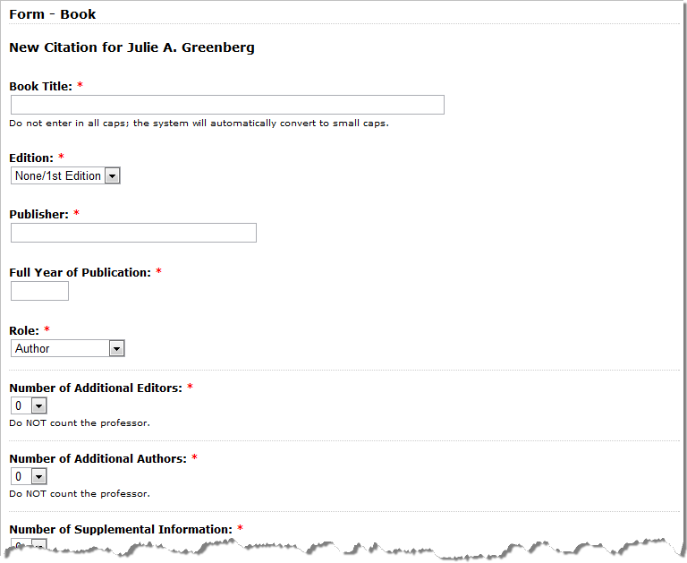
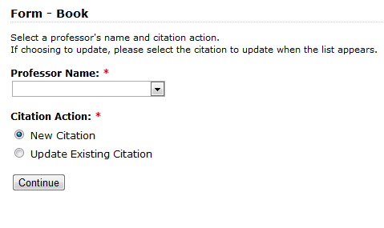
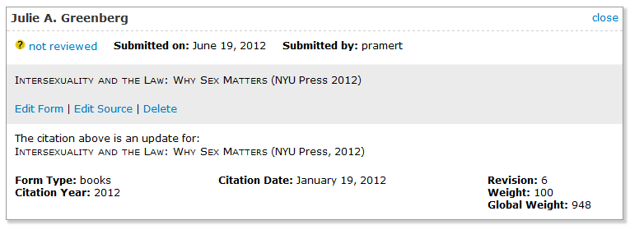
Scholar Workflow
Notes:
Workflow
Professor or Faculty Assistants complete and submit the form
Submission goes into Library or Communications review queue
Library or Communications edits the citation (if necessary) and marks the citation as reviewed
Citation automatically appears on the professor profile and designated areas on the site.

Slide 26
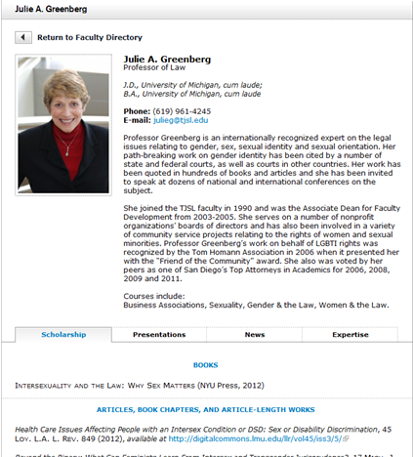
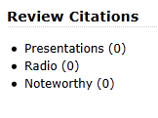
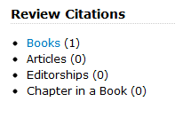
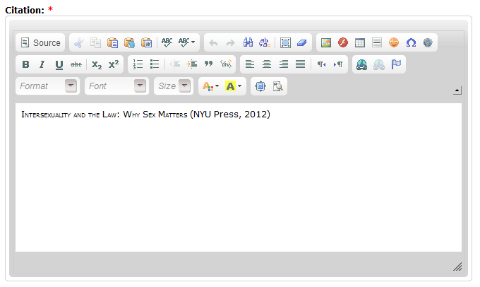
Scholar Workflow (con’t)
Reviewed
Display on site
Not reviewed
Edit Form
(if applicable)
Not reviewed
Edit Source
Notes:
Workflow
Professor or Faculty Assistants complete and submit the form
Submission goes into Library or Communications review queue
Library or Communications edits the citation (if necessary) and marks the citation as reviewed
Citation automatically appears on the professor profile and designated areas on the site.

Slide 27
CLICK

Slide 28
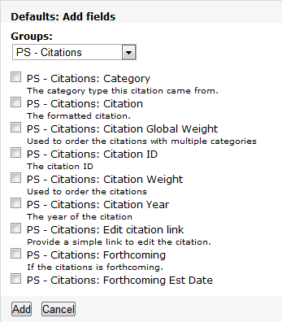
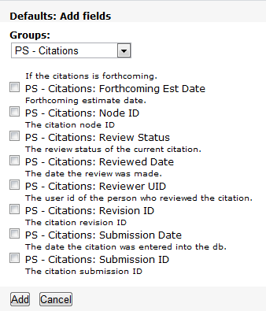
Views

Slide 29
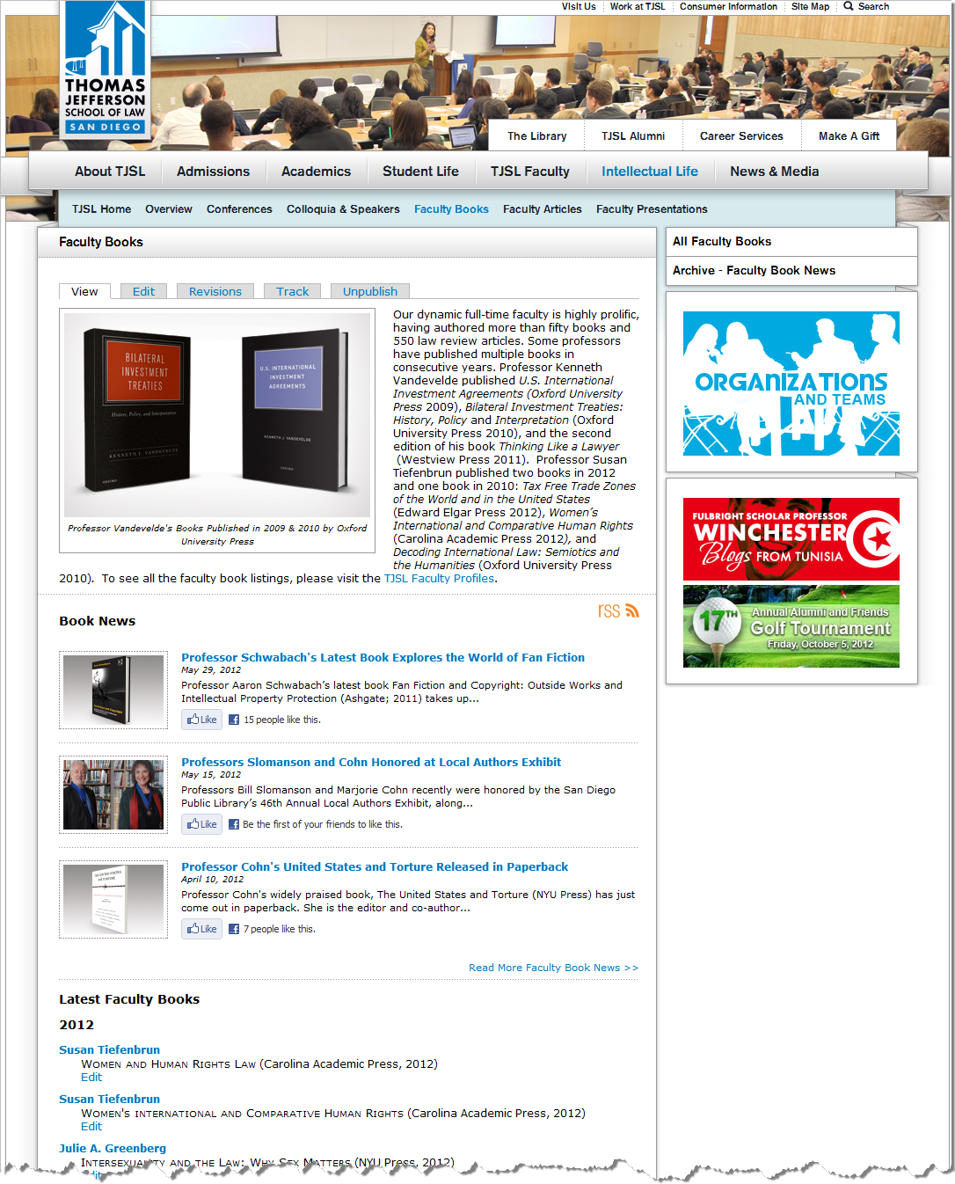
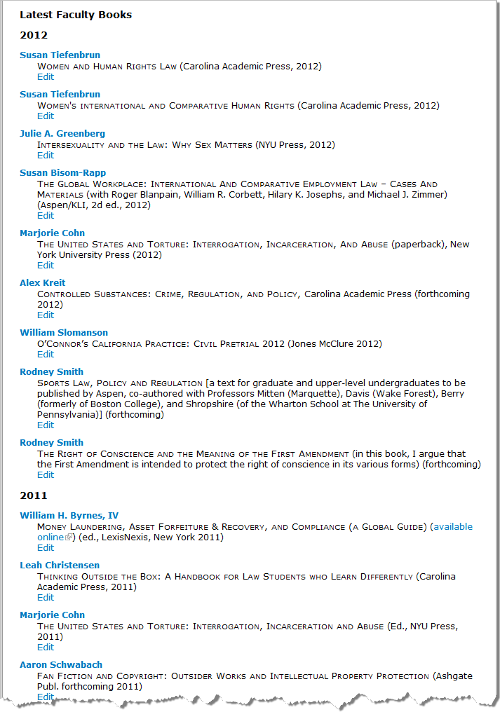
Views

Slide 30
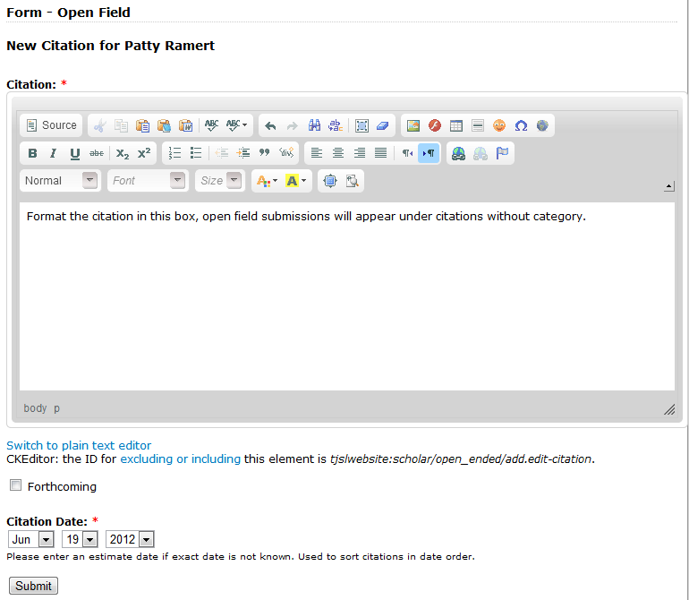
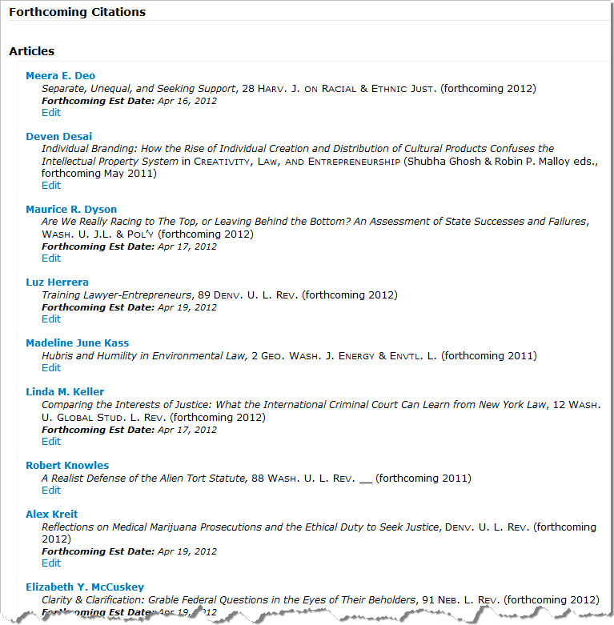
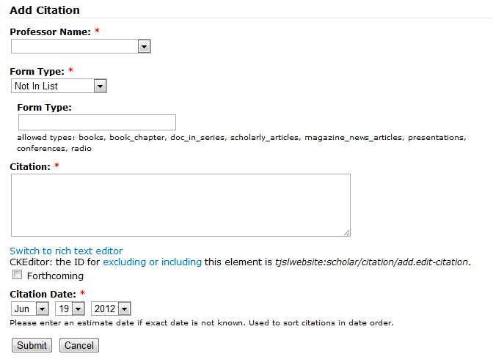
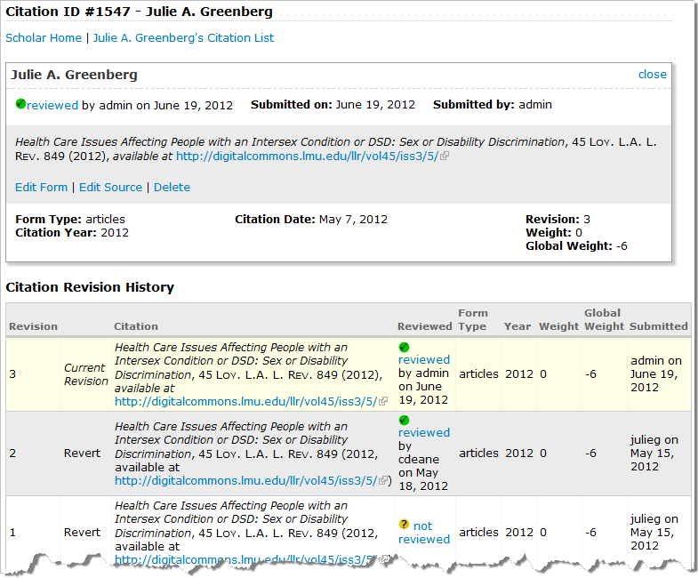
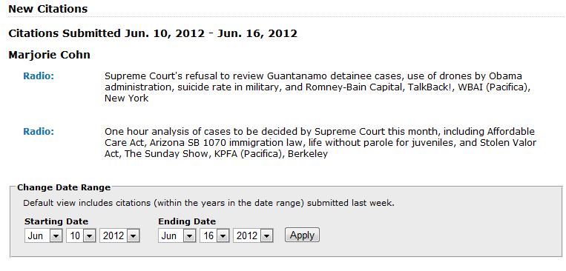
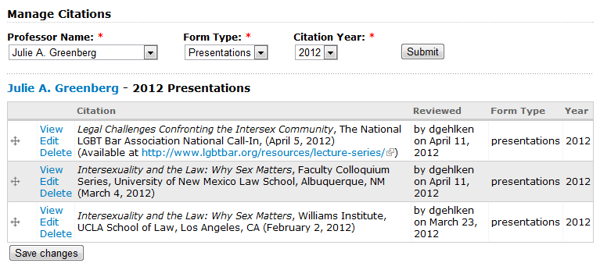
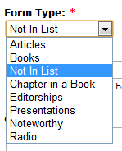
Extra Features
Forthcoming
New Citations List
Admin
Add Citation
Open-Field Form (aka “not in list”)
Manage Citation

Slide 31
DEMO

Slide 32
Future
Continue to improve auto-generated citations
Word doc download
Revert/Delete History
Email alerts
More citation types
Notes:
Future
Download Word Doc
Email alerts
More citation types

Slide 33
Thank You!
Questions? Comments?

